Slide 1
Understanding “Graph Machine Learning in the Era of Large Language Models (LLMs)”
Isamu Isozaki

Slide 2
2 Main Papers
Graph Machine Learning in the Era of Large Language Models (LLMs). Released 23 Apr 2024
Large Language Models on Graphs: A Comprehensive Survey Released 1 Feb 2024

Slide 3
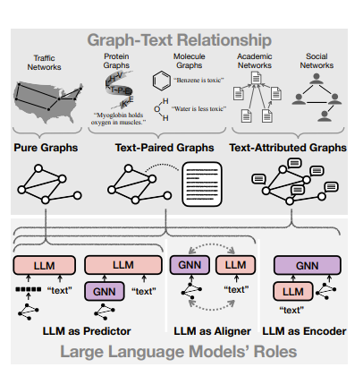
Agenda
Basic introduction to Graph ML
LLM as Encoder
LLM as Predictor
LLM as Aligner
KGs with LLMs

Slide 4
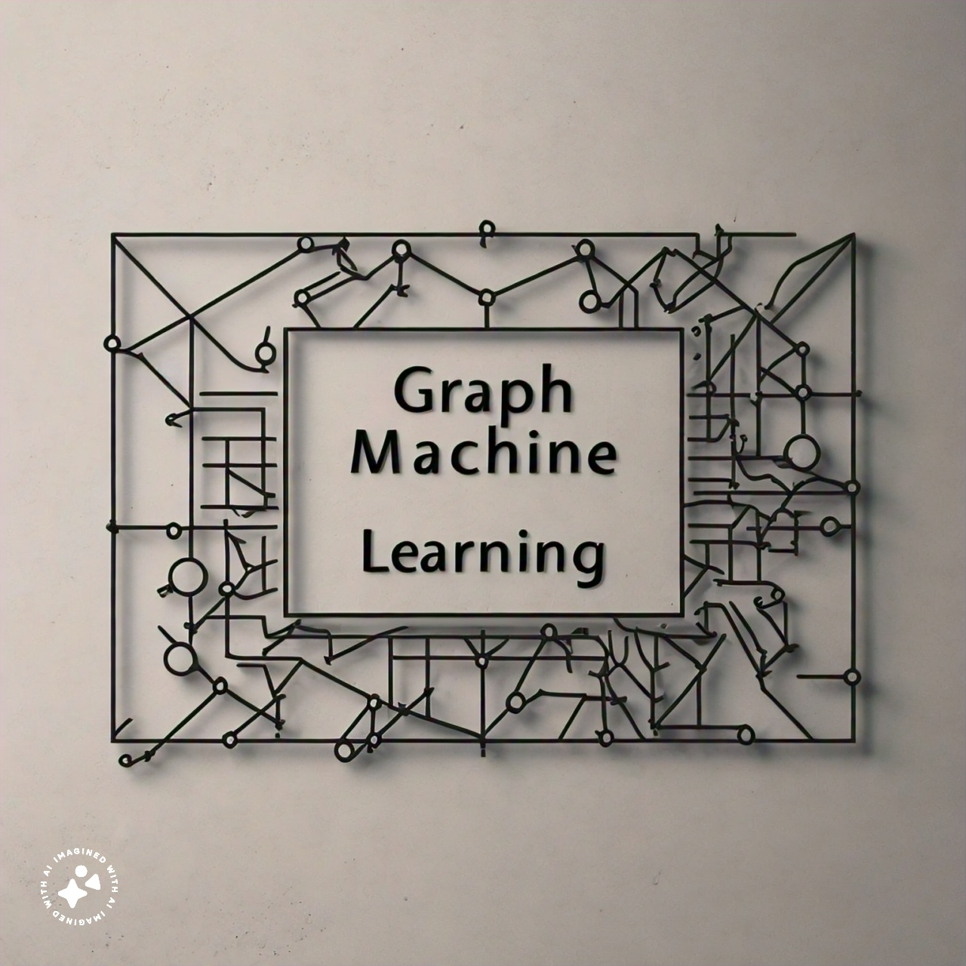
Introduction to

Slide 5
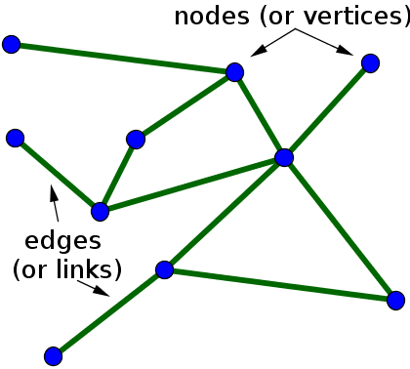
Goal of graph ML
The goal of Graph ML is to somehow get a “good” representation of a graph. Here, we want to put the representations in nodes and edges in the form of vectors!

Slide 6
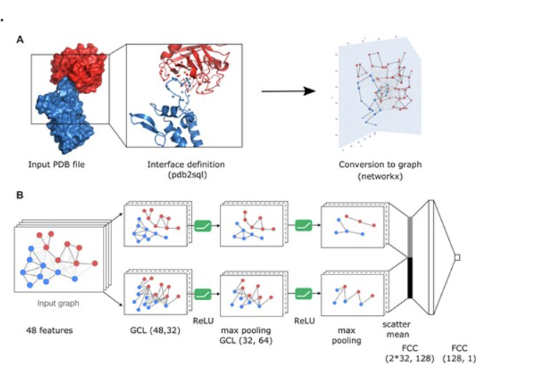
“DeepRank-GNN: a graph neural network framework to learn patterns in protein–protein interfaces”

Slide 7
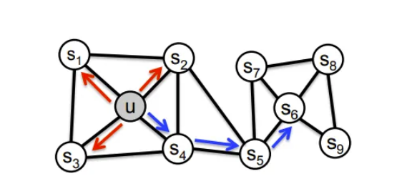
First Basic Graph ML=Random Walks
Built up to “node2vec: Scalable Feature Learning for Networks” by Stanford University in 2016

Slide 8
First Basic Graph ML=Random Walks
Start with a random node on the graph
Do a “random walk” along the edges of the graph to visit nodes
Then you will get sequence of nodes, such as u, s2, s5 or s1, s3, s4, s2 etc which look like words!

Slide 9
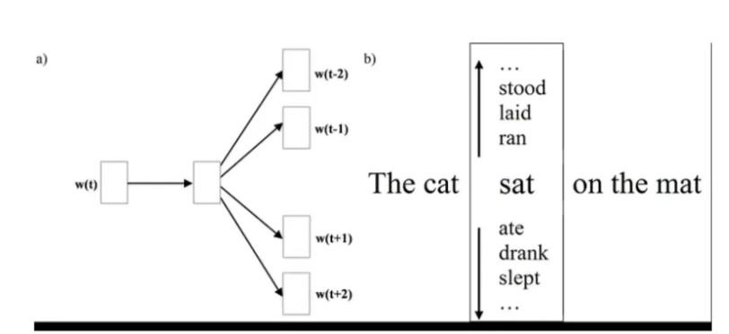
SKIPGRAM!
From Skip-Gram: NLP context words prediction algorithm

Slide 10
Limitation
Expects one layer NN to have enough representation power to represent a graph
Needs worrying about hyper params ex, how many random walks we have to do, how long for each walk, what window size should we use etc
Overall a decent method but not scalable

Slide 11
GNNs!
I worked with GNNs a bit before and I’ll use this paper since I love the visualizations: “House-GAN: Relational Generative Adversarial Networks for Graph-constrained House Layout Generation”

Slide 12
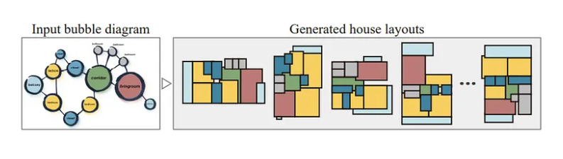
Task for House GAN:
How??

Slide 13
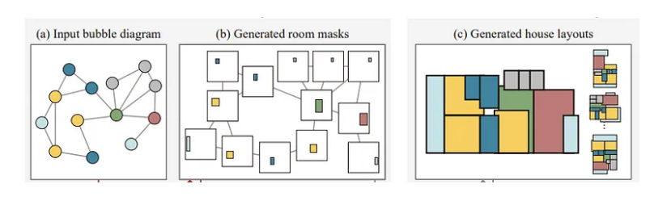
Make Each node generate a room!
But how do we know that the rooms don’t overlap/are connected?

Slide 14
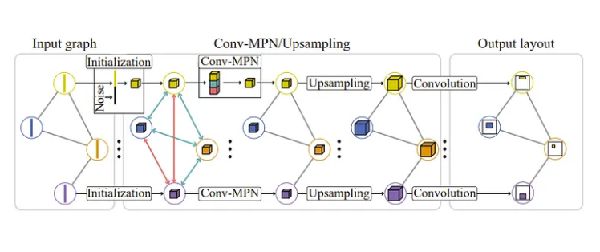
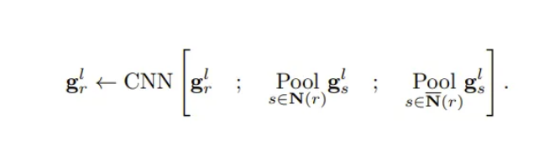
Message Passing Networks!

Slide 15
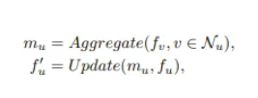
In general: Initial GNNs follow

Slide 16
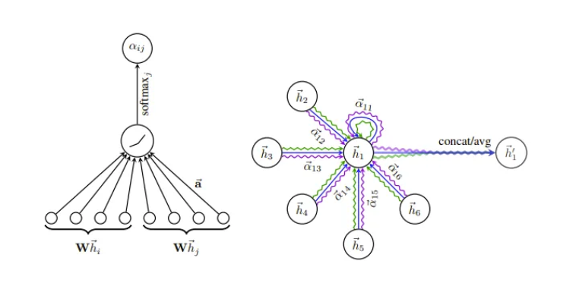
We Can Have more creative Aggregation
Graph Attention Networks

Slide 17
Limitations
The paper calls these methods “Neighborhood Aggregation-based Model” and the limitations is simple
If a graph is too large, we can find local neighborhoods but every node won’t know about every node without a lot of iterations

Slide 18
One important BEnefit
However, I’d like to highlight one benefit. We don’t have to have the adjacency matrix/work on it.
So the memory is just O(n) not O(n^2)!

Slide 19
Graph Transformer-based Model
“Do Transformers Really Perform Bad for Graph Representation?” by Microsoft
Around time when transformers were exploding in images and text but not in graphs
Basic question is how can we modify pure attention minimally to make transformers actually work good in graphs?

Slide 20
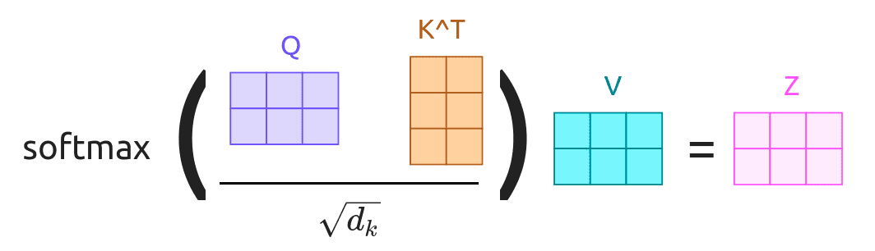
Basic Background in Attention
Graphic from https://erdem.pl/2021/05/introduction-to-attention-mechanism/

Slide 21
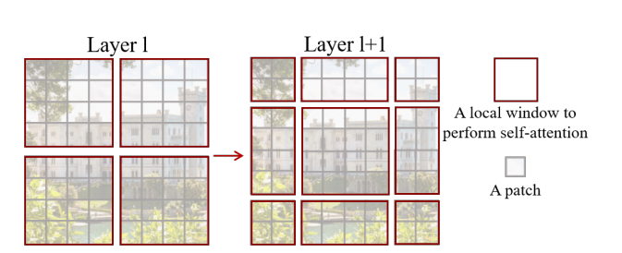
In vision, transformers had to be modified to work too
Swin Transformer: Hierarchical Vision Transformer using Shifted Windows
Some inductive bias is good

Slide 22
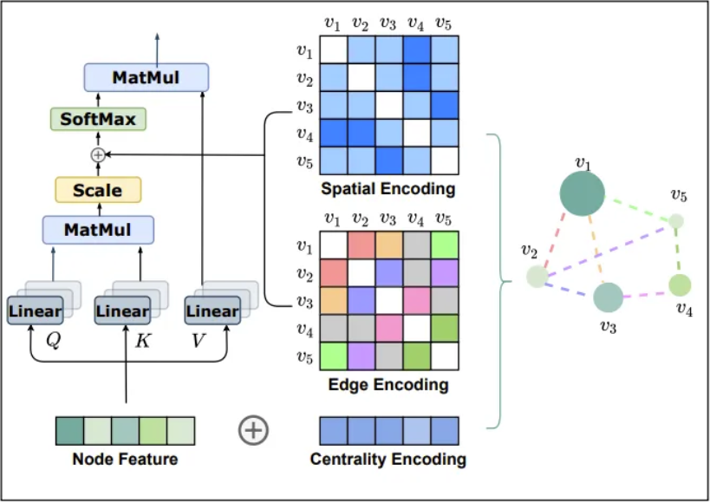
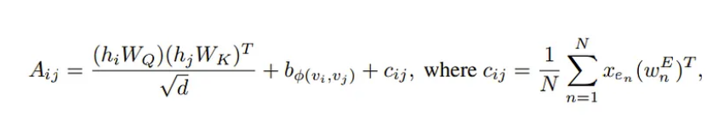
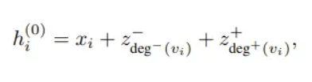
Shortest path embedding!

Slide 23
Limitations
We serialize the graph which might make us lose the structural information despite the additions we did.
To combat the above we can try getting good representations using self supervised learning!

Slide 24
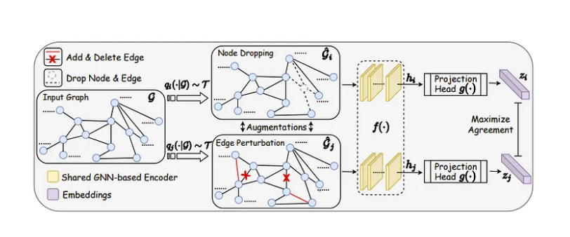
“Graph contrastive learning with augmentation “

Slide 25
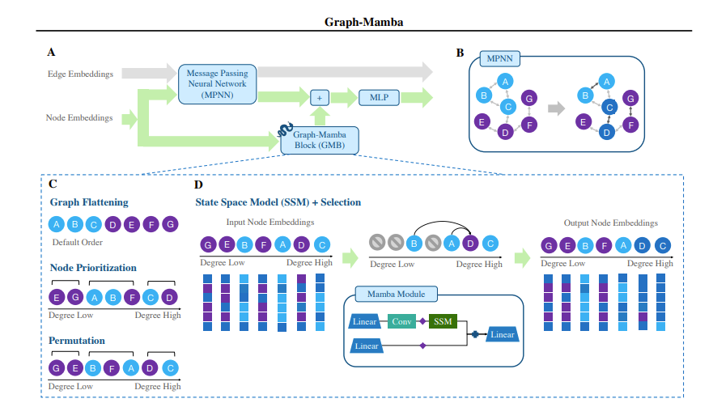
But overall, GNNs have limitations
1. Do not generalize to OOD
2. Can’t scale past the size of graph learned
3. For Graph Transformers, while more promising, O(n^2)
-> “Graph-Mamba: Towards Long-Range Graph Sequence Modeling with Selective State Spaces”?

Slide 26
But another solution
Can we plug LLMs into graphs to make them work with OOD data?

Slide 27
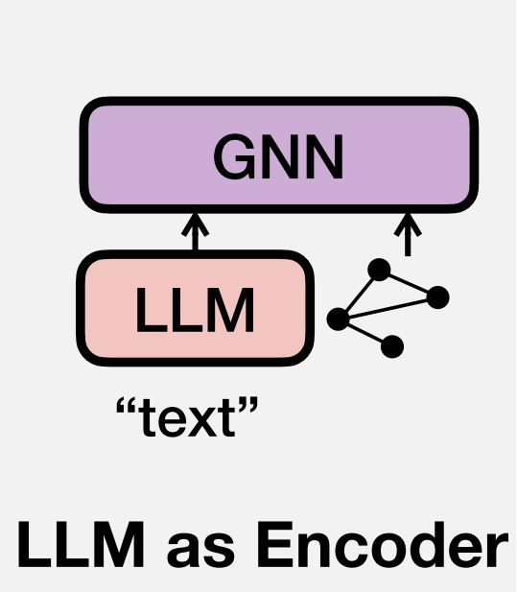

Slide 28
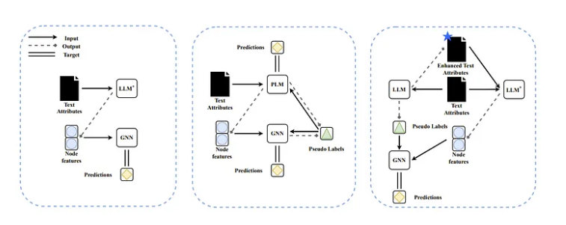
“Exploring the Potential of Large Language Models (LLMs) in Learning on Graphs”
Just encode text features into GNN nodes!

Slide 29
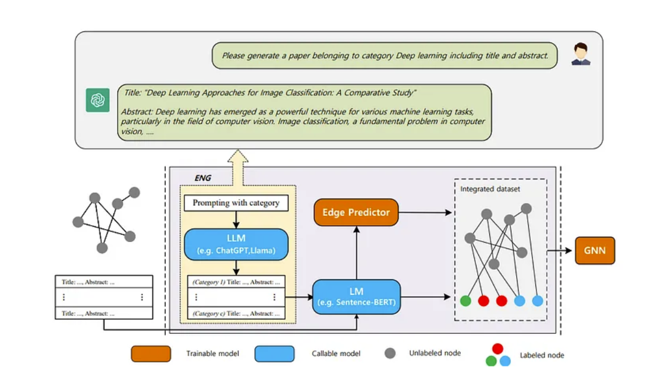
“Empower Text-Attributed Graphs Learning with Large Language Models (LLMs)” – Have llm Refine Graph!

Slide 30
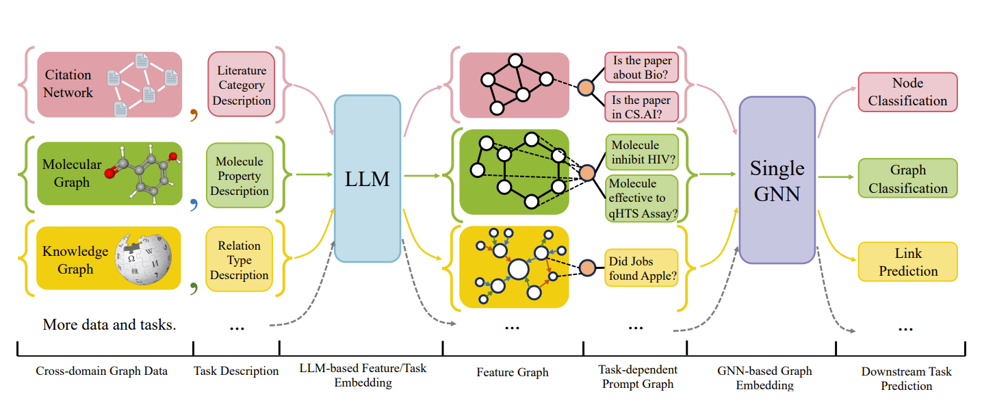
“One for All: Towards Training One Graph Model for All Classification Tasks”-Make GNN work with multiple Graph Tasks

Slide 31
Limitation
Need labeled data to train the GNN on
Can we have the LLM solve the task itself?

Slide 32
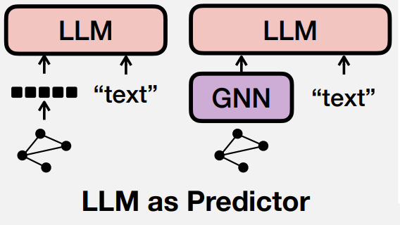

Slide 33
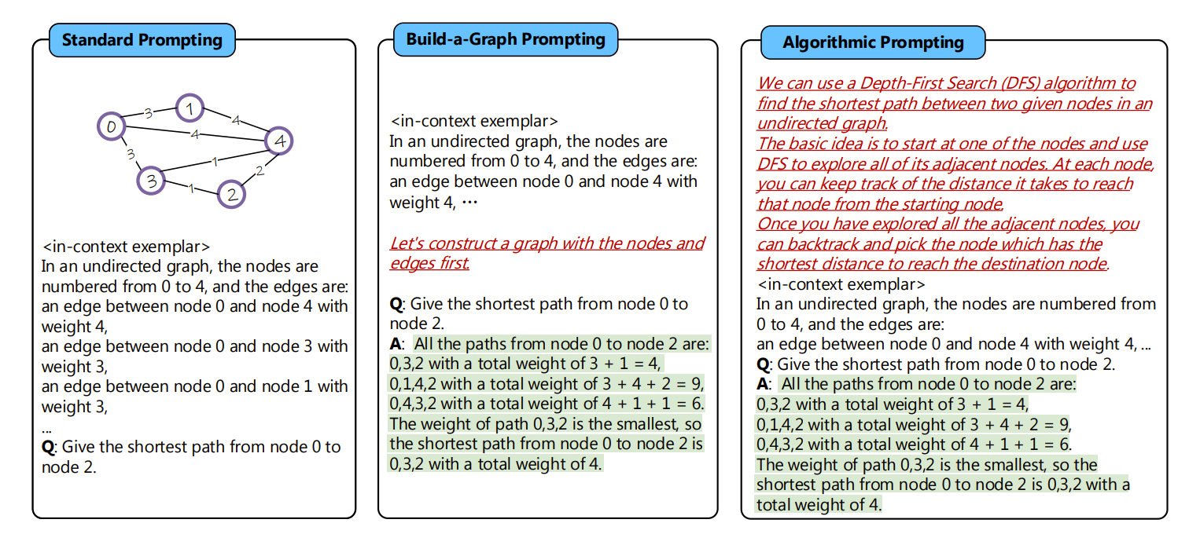
“Can Language Models Solve Graph Problems in Natural Language?”

Slide 34
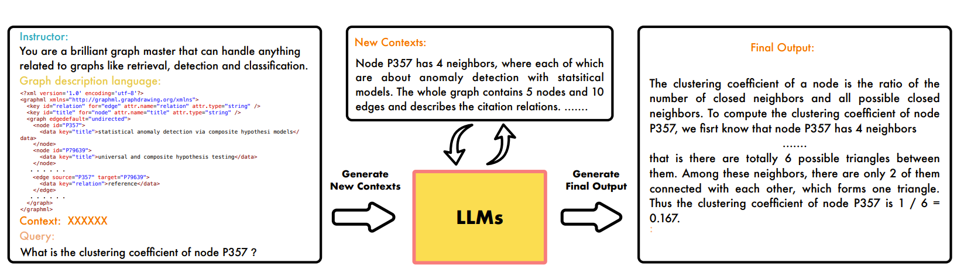
“GPT4Graph: Can Large Language Models Understand Graph Structured Data? An Empirical Evaluation and Benchmarking”

Slide 35
Summary
Major strategy seems to input data, make LLM understand the graph, and then ask the question
Limitation: it’s not scalable to large graphs!

Slide 36
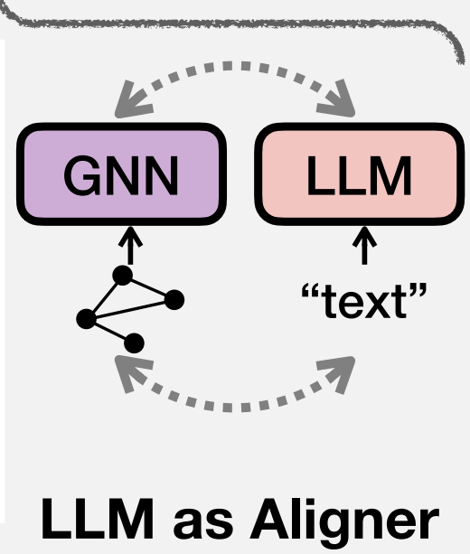

Slide 37
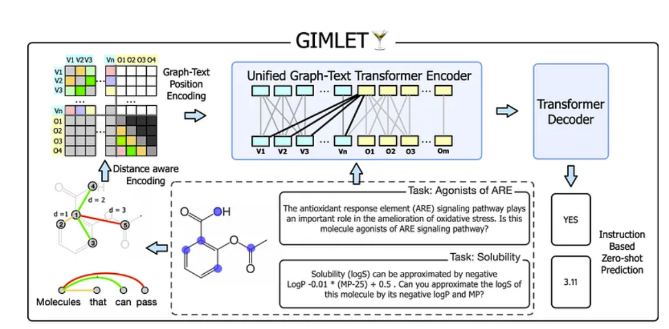
“Gimlet: A unified graph-text model for instruction-based molecule zero-shot learning” – Same Positional encoding!

Slide 38
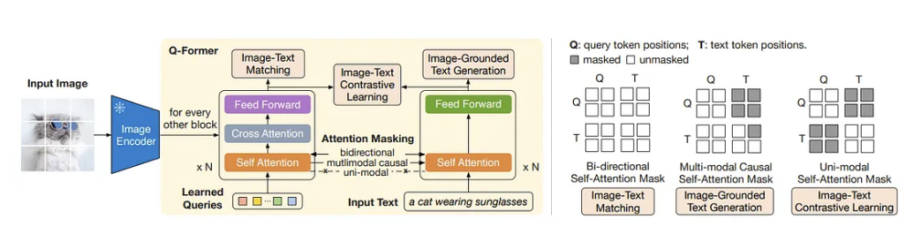
In the Image world: BLIP 2!
Information is added via crossed attention and then encoded into the learned query
Bottlenecks!

Slide 39
Inspired by this: “GIT-Mol: A Multi-modal Large Language Model for Molecular Science with Graph, Image, and Text”

Slide 40
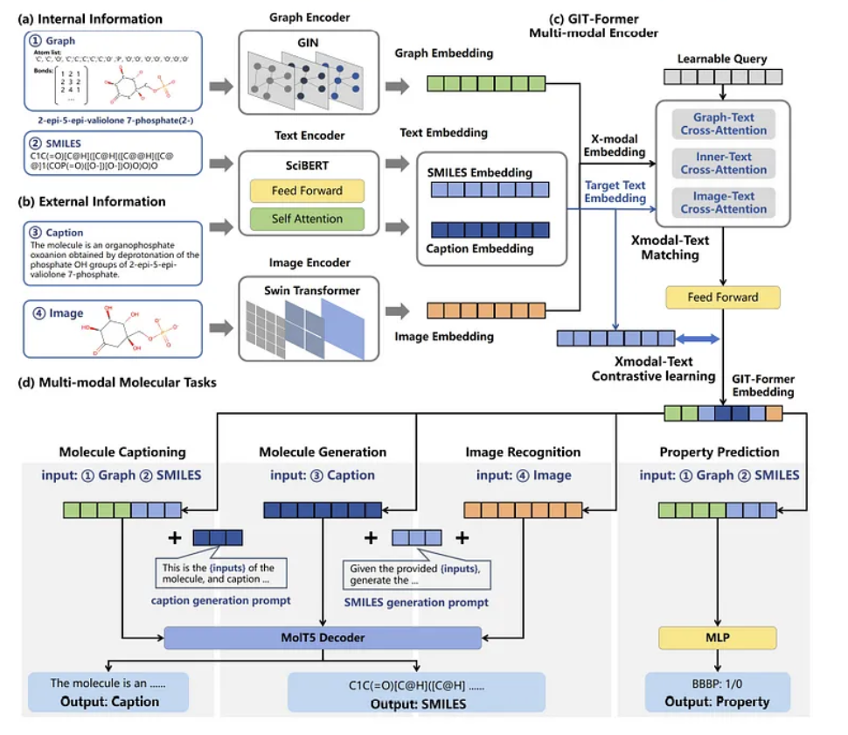

Slide 41
Limitations
This is bottlenecked by GNN limitation: This approach suffers if adjacent nodes lack similarity, which is one of the assumptions of GNNs. Also maybe for OOD issue

Slide 42
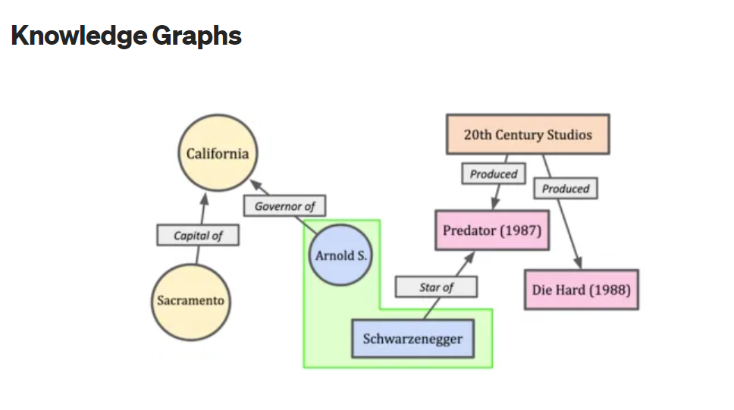

Slide 43
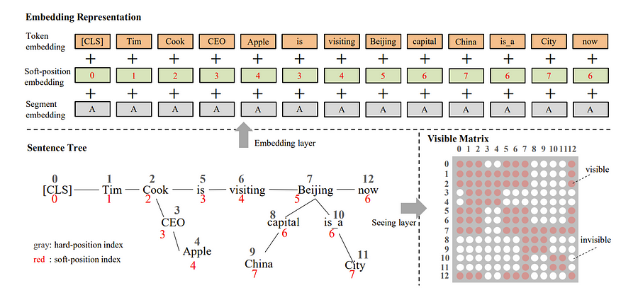
"K-BERT: Enabling Language Representation with Knowledge Graph“-Slightly more than modifying prompt

Slide 44
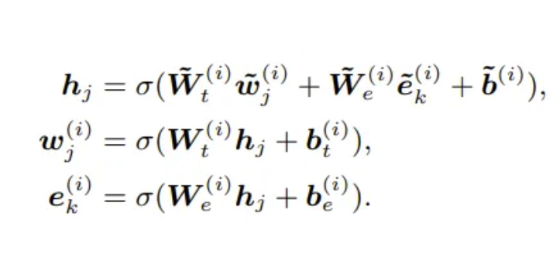
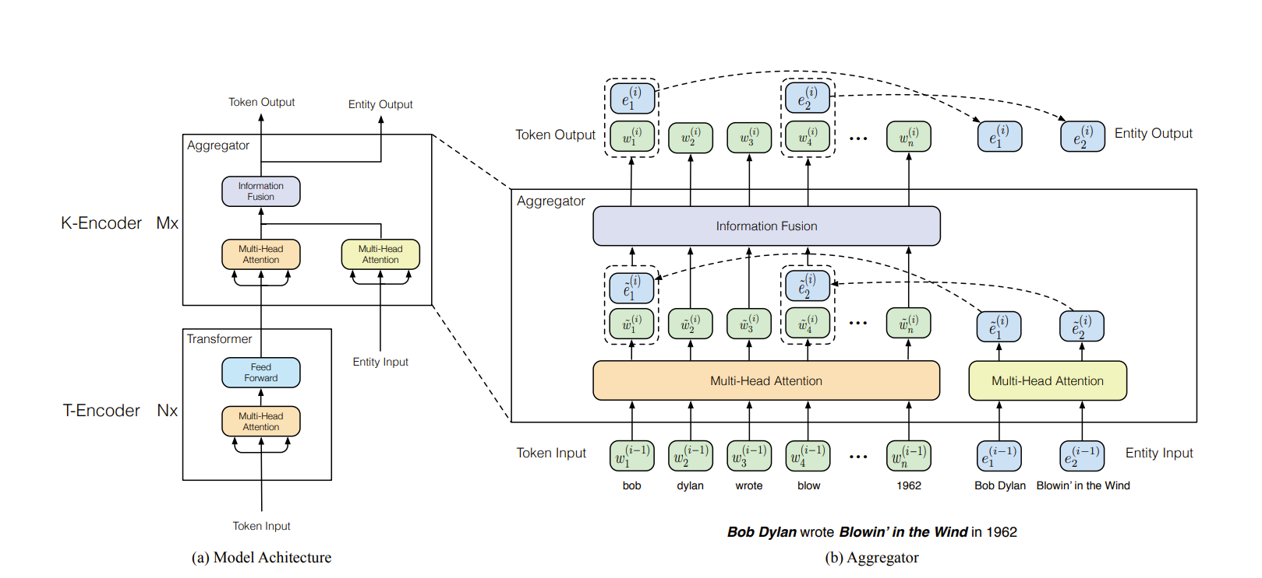
“ERNIE: Enhanced Language Representation with Informative Entities”
But can we do an adapter instead?

Slide 45
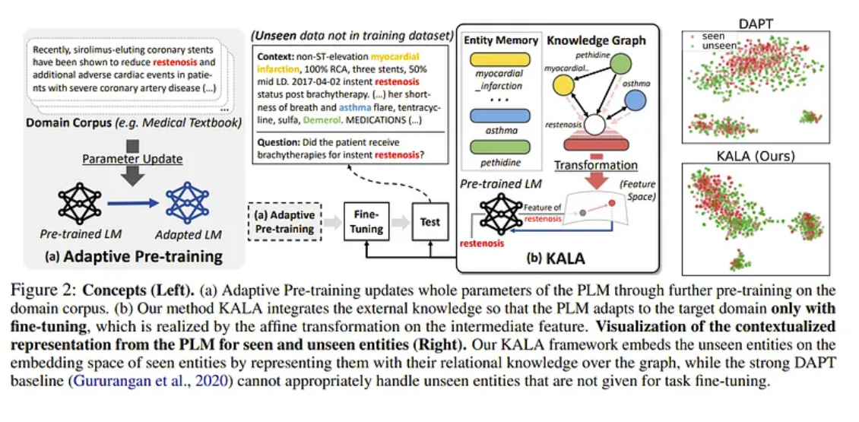
“KALA: Knowledge-Augmented Language Model Adaptation”

Slide 46
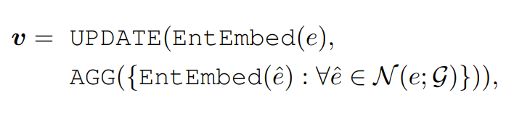
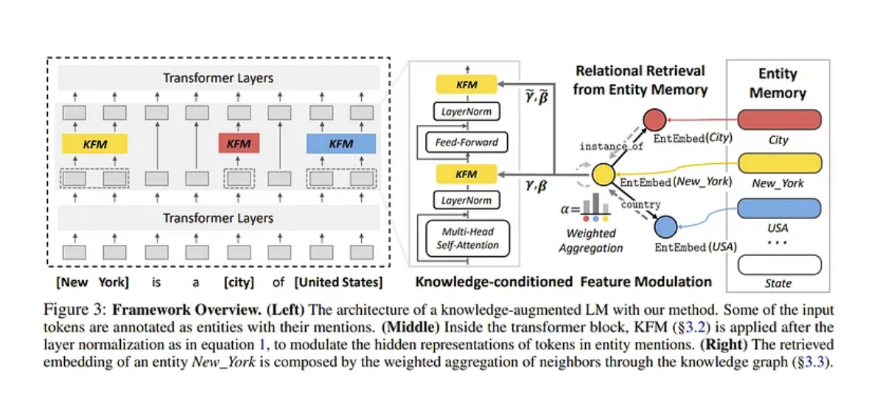
Adapter Architecture

Slide 47
Limitations
We need, for most of these approaches, to modify the LLM and train a bit to make it work
Is there an inference only solution?

Slide 48
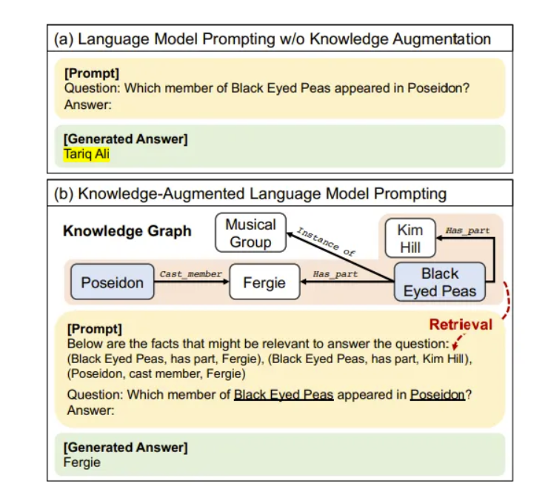
Idea 1: Just plug in “Knowledge-Augmented Language Model Prompting for Zero-Shot Knowledge Graph Question Answering”

Slide 49
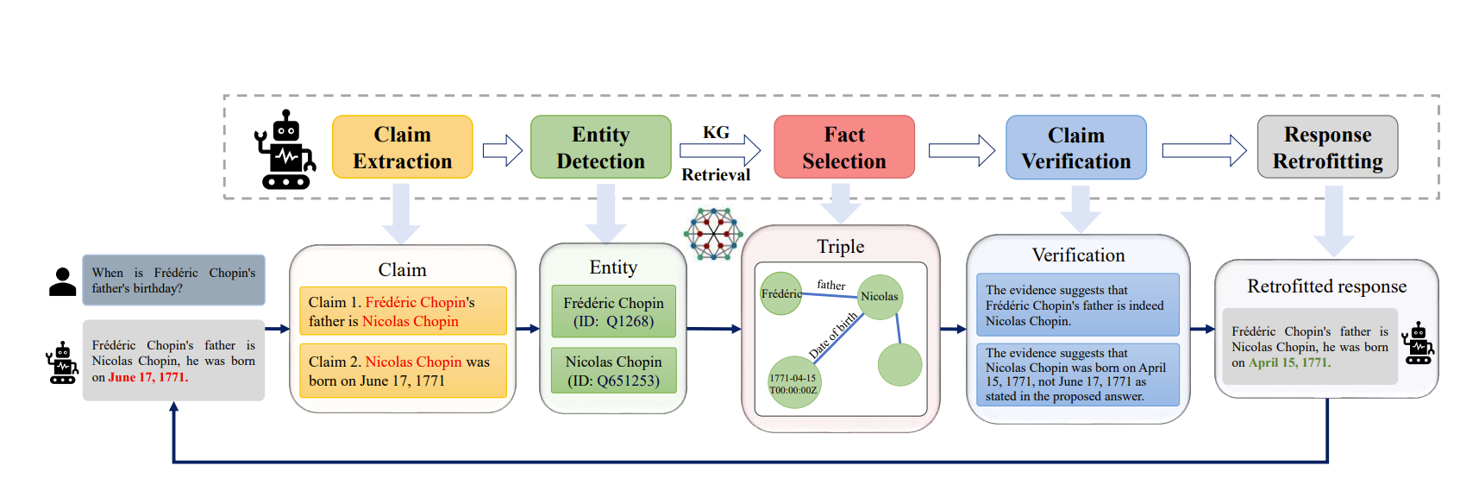
“Mitigating Large Language Model Hallucinations via Autonomous Knowledge Graph-based Retrofitting”

Slide 50
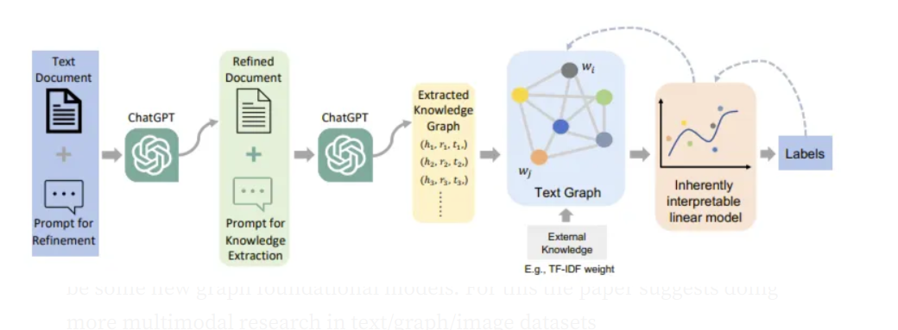
KG to GNNs! “ChatGraph: Interpretable Text Classification by Converting ChatGPT Knowledge to Graphs”

Slide 51
Conclusion of Paper
Generalizability
GNNs suffer from OOD samples. LLMs seem to help in this but it’s yet to be seen if GNNs are the best architecture for generalizing or whether there will be some new graph foundational models. For this the paper suggests doing more multimodal research in text/graph/image datasets
2. Efficiency
Graphs in particular can grow in size exponentially with each added node which makes working with LLMs, for example GPT4, very expensive. There is a need to be more efficient.

Slide 52
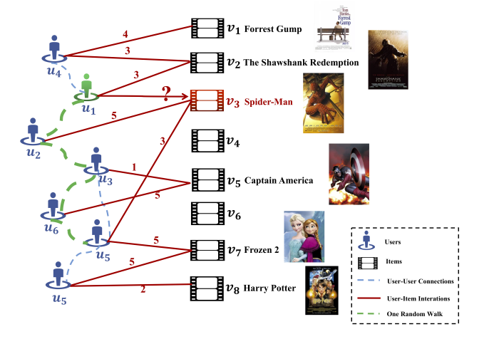
Applications: Recommendation Systems “Deep Social Collaborative Filtering”

Slide 53
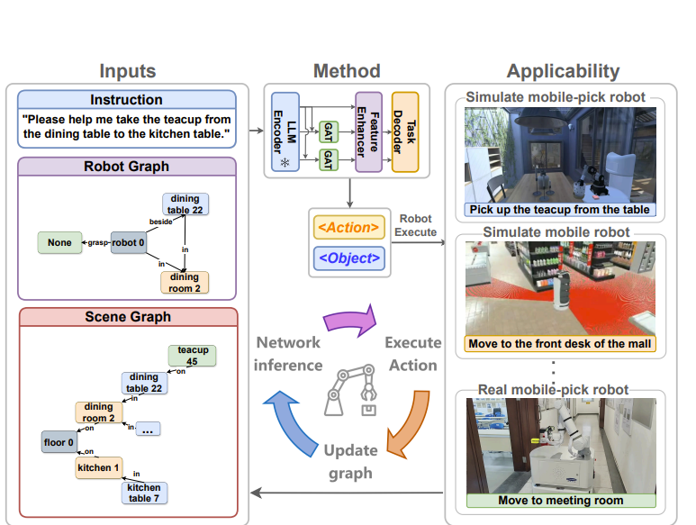
Applications: Robot task Planning “GRID: Scene-Graph-based Instruction-driven Robotic Task Planning“

Slide 54
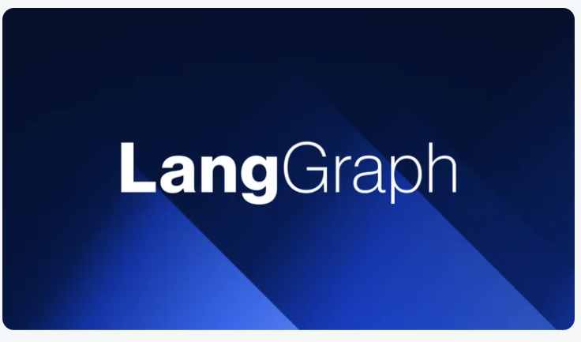

Conclusion
A bit surprised there wasn’t much on constrained generation + graphs or graphs for planning for LLMs
Adding nodes with GNNs(Definitely done somewhere but not mentioned much)
Increasing math capability/logic using graphs
Quantizing graphs
But might be future direction

Slide 55
Thank you

